Slide 1
Artificial Intelligence
Knowledge Representation

Slide 2
Representation
AI agents deal with knowledge (data)
  Facts (believe & observe knowledge)
  Procedures (how to knowledge)
  Meaning (relate & define knowledge)
Right representation is crucial
  Early realisation in AI
  Wrong choice can lead to project failure
  Active research area

Slide 3
What is a Logic?
A language with concrete rules
  No ambiguity in representation (may be other errors!)
  Allows unambiguous communication and processing
  Very unlike natural languages e.g. English
Many ways to translate between languages
  A statement can be represented in different logics
  And perhaps differently in same logic
Expressiveness of a logic
  How much can we say in this language?
Not to be confused with logical reasoning
  Logics are languages, reasoning is a process (may use logic)

Slide 4
Syntax and Semantics
Syntax
  Rules for constructing legal sentences in the logic
  Which symbols we can use (English: letters, punctuation)
  How we are allowed to combine symbols
Semantics
  How we interpret (read) sentences in the logic
  Assigns a meaning to each sentence
Example: “All lecturers are seven foot tall”
  A valid sentence (syntax)
  And we can understand the meaning (semantics)
  This sentence happens to be false (there is a counterexample)

Slide 5

Propositional Logic
Syntax
  Propositions, e.g. “it is wet”
  Connectives: and, or, not, implies, iff (equivalent)
  Brackets, T (true) and F (false)
Semantics (Classical AKA Boolean)
  Define how connectives affect truth
    “P and Q” is true if and only if P is true and Q is true
  Use truth tables to work out the truth of statements

Slide 6
Predicate Logic
Propositional logic combines atoms
  An atom contains no propositional connectives
  Have no structure (today_is_wet, john_likes_apples)
Predicates allow us to talk about objects
  Properties: is_wet(today)
  Relations: likes(john, apples)
  True or false
In predicate logic each atom is a predicate
  e.g. first order logic, higher-order logic

Slide 7
First Order Logic
More expressive logic than propositional
  Used in this course (Lecture 6 on representation in FOL)
Constants are objects: john, apples
Predicates are properties and relations:
  likes(john, apples)
Functions transform objects:
  likes(john, fruit_of(apple_tree))
Variables represent any object: likes(X, apples)
Quantifiers qualify values of variables
  True for all objects (Universal): ∀X. likes(X, apples)
  Exists at least one object (Existential): ∃X. likes(X, apples)

Slide 8
Example: FOL Sentence
“Every rose has a thorn”
For all X
  if (X is a rose)
  then there exists Y
    (X has Y) and (Y is a thorn)

Slide 9
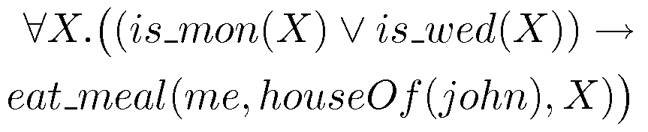
Example: FOL Sentence
“On Mondays and Wednesdays I go to John’s house for dinner”
Note the change from “and” to “or”
  Translating is problematic

Slide 10
Logic is a Good Representation
Fairly easy to do the translation when possible
Branches of mathematics devoted to it
It enables us to do logical reasoning
  Tools and techniques come for free
Basis for programming languages
  Prolog uses logic programs (a subset of FOL)
  λProlog based on HOL

Slide 11
Non-Logical Representations?
Production rules
Semantic networks
  Frames
Logic representations have restrictions and can be hard to work with
  Many AI researchers searched for better representations

Slide 12
Production Rules
Rule set of <condition,action> pairs
  “if condition then action”
Match-resolve-act cycle
  Match: Agent checks if each rule’s condition holds
  Resolve:
    Multiple production rules may fire at once (conflict set)
    Agent must choose rule from set (conflict resolution)
  Act: If so, rule “fires” and the action is carried out
Working memory:
  rule can write knowledge to working memory
  knowledge may match and fire other rules

Slide 13
Production Rules Example
IF (at bus stop AND bus arrives) THEN action(get on the bus)
IF (on bus AND not paid AND have oyster card) THEN action(pay with oyster) AND add(paid)
IF (on bus AND paid AND empty seat) THEN sit down
conditions and actions must be clearly defined
  can easily be expressed in first order logic!

Slide 14
Knowledge Representation as a medium for human expression
An intelligent system must have KRs that can be interpreted by humans.
  – We need to be able to encode information in the knowledge base
  without significant effort.
  We need to be able to understand what the system knows and how it draws its conclusions.
Notes:
Predicate calculus and semantic nets can denote objects in the domain only
by using simple symbols. Other representatons, such as frames, let us define
complex structures by encapsulating multiple features and attributes
to indicate a single object in the domain.

Slide 15
Knowledge Representation
Logic (prepositional, predicate)
Network representation
  Semantic nets
Structured representation
  Frames
Notes:
In building a knowledge base, a programmer must select the significant objects and relations in the domain and map these into a formal language. The resulting program must contain sufficient knowledge to solve problems in the domain, it must make correct inferences from this knowledge, and it must do so efficiently.

Slide 16
Semantic Networks
First introduced by Quillian back in the late-60s
    M. Ross Quillian. "Semantic Memories", In M. M. Minsky, editor, Semantic
    Information Processing, pages 216-270. Cambridge, MA: MIT Press, 1968
Semantic network is simple representation scheme which uses a graph of labeled nodes and labeled directed arcs to encode knowledge
  Nodes – objects, concepts, events
  Arcs – relationships between nodes
Graphical depiction associated with semantic networks is a big reason for their popularity

Slide 17
Nodes and Arcs
Arcs define binary relations which hold between objects denoted by the nodes.
mother (john, sue)
age (john, 5)
wife (sue, max)
age (max, 34)
…
Sue
mother
John
age
5
wife
father
age
husband
34
Max

Slide 18
Non-binary relations
We can represent the generic give event as a relation involving three things:
  A giver
  A recipient
  An object
Mary
recipient
GIVE
giver
John
object
book

Slide 19
Inheritance
Animal
Inheritance is one of the main kind of reasoning done in semantic nets
The ISA (is a) relation is often used to link a class and its superclass.
Some links (e.g. haspart) are inherited along ISA paths
The semantics of a semantic net can be relatively informal or very formal
  Often defined at the implementation level
isa
Bird
hasPart
Wings
isa
Robin
isa
isa
Rusty
Red

Slide 20
Frames
Frames – semantic net with properties
A frame represents an entity as a set of slots (attributes) and associated values
A frame can represent a specific entry or a general concept
Frames are implicitly associated with one another because the value of a slot can be another frame
Book Frame
Slot → Filler
Title → AI. A modern Approach Author → Russell & Norvig Year → 2003
3 components of a frame
  frame name
  attributes (slots)
  values (fillers: list of values, range, string, etc.)

Slide 21
Features of Frame Representation
More natural support of values then semantic nets (each slots has constraints describing legal values that a slot can take).
Can be easily implemented using object-oriented programming techniques.
Inheritance is easily controlled.

Slide 22
Inheritance
Similar to Object-Oriented programming paradigm
Hotel Chair
what → chair height →20-40cm legs → 4
Hotel Phone
what → phone billing → guest
Hotel Room
what → room where →hotel contains→ hotel chair hotel phone hotel bed
Hotel Bed
what → bed size →king part → mattress
Mattress
price → 100$

Slide 23
Benefits of Frames
Makes programming easier by grouping related knowledge
Easily understood by non-developers
Expressive power
Easy to set up slots for new properties and relations
Easy to include default information and detect missing values

Slide 24
Drawbacks of Frames
No standards (slot-filler values)
More of a general methodology than a specific representation:
  Frame for a class-room will be different for a professor and for a maintenance worker
No associated reasoning/inference mechanisms

Slide 25
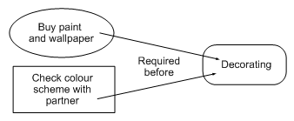

Graphical Representation
Humans draw diagrams all the time, e.g.
  Causal relationships
  And relationships between ideas

Slide 26
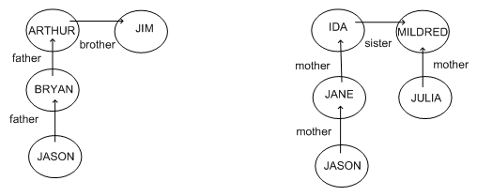
Graphical Representation
Graphs easy to store in a computer
To be of any use must impose a formalism
  Jason is 15, Bryan is 40, Arthur is 70, Jim is 74
  How old is Julia?

Slide 27
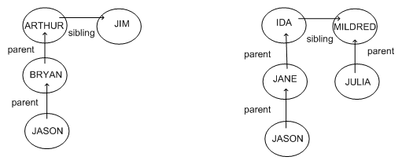
Semantic Networks
Because the syntax is the same
  We can guess that Julia’s age is similar to Bryan’s
Formalism imposes restricted syntax

Slide 28
Semantic Networks
Graphical representation (a graph)
  Links indicate subset, member, relation, ...
Equivalent to logical statements (usually FOL)
  Easier to understand than FOL?
  Specialised SN reasoning algorithms can be faster
Example: natural language understanding
  Sentences with same meaning have same graphs
  e.g. Conceptual Dependency Theory (Schank)

Slide 29
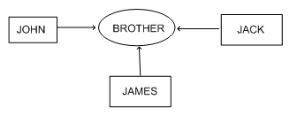
Conceptual Graphs
Semantic network where each graph represents a single proposition
Concept nodes can be
  Concrete (visualisable) such as restaurant, my dog Spot
  Abstract (not easily visualisable) such as anger
Edges do not have labels
  Instead, conceptual relation nodes
  Easy to represent relations between multiple objects

Slide 30
Frame Representations
Semantic networks where nodes have structure
  Frame with a number of slots (age, height, ...)
  Each slot stores specific item of information
When agent faces a new situation
  Slots can be filled in (value may be another frame)
  Filling in may trigger actions
  May trigger retrieval of other frames
Inheritance of properties between frames
  Very similar to objects in OOP

Slide 31
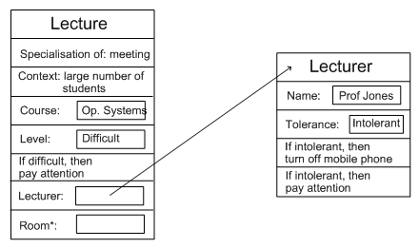
Example: Frame Representation

Slide 32
Flexibility in Frames
Slots in a frame can contain
  Information for choosing a frame in a situation
  Relationships between this and other frames
  Procedures to carry out after various slots filled
  Default information to use where input is missing
  Blank slots: left blank unless required for a task
  Other frames, which gives a hierarchy
Can also be expressed in first order logic

Slide 33
Representation & Logic
AI wanted “non-logical representations”
  Production rules
  Semantic networks
    frames
But all can be expressed in first order logic!
Best of both worlds
  Logical reading ensures representation well-defined
  Representations specialised for applications
  Can make reasoning easier, more intuitive

